Slide 1
COURT AT
DOOR
Lawyer Navigation Website
Masira Samdole
Kalyani Prabhudesai
Vaishnavi Suryavanshi
Gayatri Salunkhe

Slide 2


AGENDA
Domain Introduction
Problem Statement
Example of Applications related to our domain
Project Introduction
Literature Overview
Motivation
Objectives
System architecture
Future scope
Conclusion

Slide 3
DOMAIN INTRODUCTION
Data mining is defined as a process used to extract usable data from a larger set of any raw data
Data mining goes beyond the search process, as it uses data to evaluate
future probabilities and develop actionable analyses.
Data mining is most useful in identifying data patterns and deriving useful business insights from those patterns.
To accomplish these tasks, data miners use a variety of techniques to generate different results like we have used here classification based on location
Uses of data mining – Whether forecasting , sales , share marketing , healthcare , business and many more .
Careers in Data mining are :- Database administrator , Computer and information scientist , market research analyst , computer network architect ,information security analyst

Slide 4

Problem Statement
In today's legal landscape, individuals often struggle to find suitable legal representation that aligns with their location and budget. Traditional methods of finding lawyers can be time-consuming, inefficient, and lack transparency. To address this challenge, we propose the development of an online platform called "Court at Door." This platform aims to streamline the process of connecting users with lawyers based on their specific needs, such as location and budget constraints.

Slide 5
EXAMPLE OF APPLICATIONS RELATED TO OUR DOMAIN
Finance –
Credit scoring , Stock market analysis
Telecommunication -
Network optimization , Bandwidth detection
Marketing –
Customer behaviors , market uplifts and downfalls
Education –
Student performance analysis , personalization
Manufacturing –
Quality Control , supply chains
Health care –
Disease prediction , patient data
E-commerce –
Bar charts , frequent actions

Slide 6
PROJECT INTRODUCTION
The "Court at Door" website is designed to assist clients in finding a lawyer within their budget and preferred location. The main homepage offers three options: admin, client, and advocate.
For new clients, the account creation involves providing full name, contact information, case details, budget for a lawyer, and the type of case. Upon clicking "search," the website will match clients with lawyers based on their budget and location.
Similarly, advocates follow a similar structure with a login page offering the option to create an account. Advocates provide information such as name, contact details, speciality, practice location, and a detailed introduction.

Slide 7
LITERATURE OVERVIEW
e-Courts Project: A Giant Leap by Indian Judiciary :- Kshitiz Verma LNMIIT Jaipur This paper enumerates the efforts made by the Supreme Court of India and proposes a road map of how the existing Information and Communication Technology. The Government of India has unleashed huge amount of funds to enhance the rate of justice and reduce the piling up of huge number of cases in the courts in India.
Digital Courts: Future Of The Indian Legal System, Akshat Khetan The journey towards digitalization of India’s judicial system started in 2005 with the setting up of the Supreme Court of India’s e-Committee. Nearly 18 years later, Phase-II of the e- Courts Project is nearing completion. This Phase has focused on citizen-centric e- services while computerizing 18,735 courts and connecting them with Wide Area Networks.

Slide 8
Development of Online Legal Information System : Lawyers’ Perceptions , Raj Kumar Bhardwaj this study strives to understand the differences in perceptions of practicing and academic lawyers in the development of an online legal information system. Majority of practicing lawyers depend on discussions with colleagues as a channel for exchanging information more than external communications with others. However, there is a significant difference in the requirements of practicing and academic legal professions
Digitalization - The New Era of Indian Judiciary, Ratnesh Kumar Tiwari, Aman Singh Justice delayed is justice denied.” in Indian judiciary is on the use of technology so that manage the case proceeding in the use of the electronic format and this gives a new invention or new idea to the Indian judiciary.

Slide 9
MOTIVATION
The motivation behind the "Court at Door" website is to simplify the process of connecting clients with suitable lawyers based on their budget and case location.
It works as one step towards Hassle free and travel free traditional searching approaches eliminating the use of fraudism.
By integrating technology, the website empowers clients to make informed choices and lawyers to efficiently manage their client base.
The platform's motivation lies in enhancing accessibility, transparency, and efficiency in the legal service sector, ultimately providing a convenient solution for both clients and advocates.

Slide 10
OBJECTIVES
The website, named "court at door," aims to assist clients in finding a lawyer based on
their budget and the location where the case will take place.
The main home page provides three options: admin, client, and advocate.
Clients can log in or create an account. During account creation, clients provide personal details, contact information, case details (allocation and type), and budget for a lawyer .
The search function matches clients with lawyers based on budget and location .
Returning clients can access their previous case history and information about recruited lawyers.
Advocates can log in or create an account . Account creation requires personal details,
contact information, speciality, practice location, and a detailed introduction . Upon logging in, advocates can view their current cases, won cases, and the total number of cases handled . Advocates receive requests for information from clients and can accept or reject these requests . Accepted requests are displayed on the client's page.

Slide 11
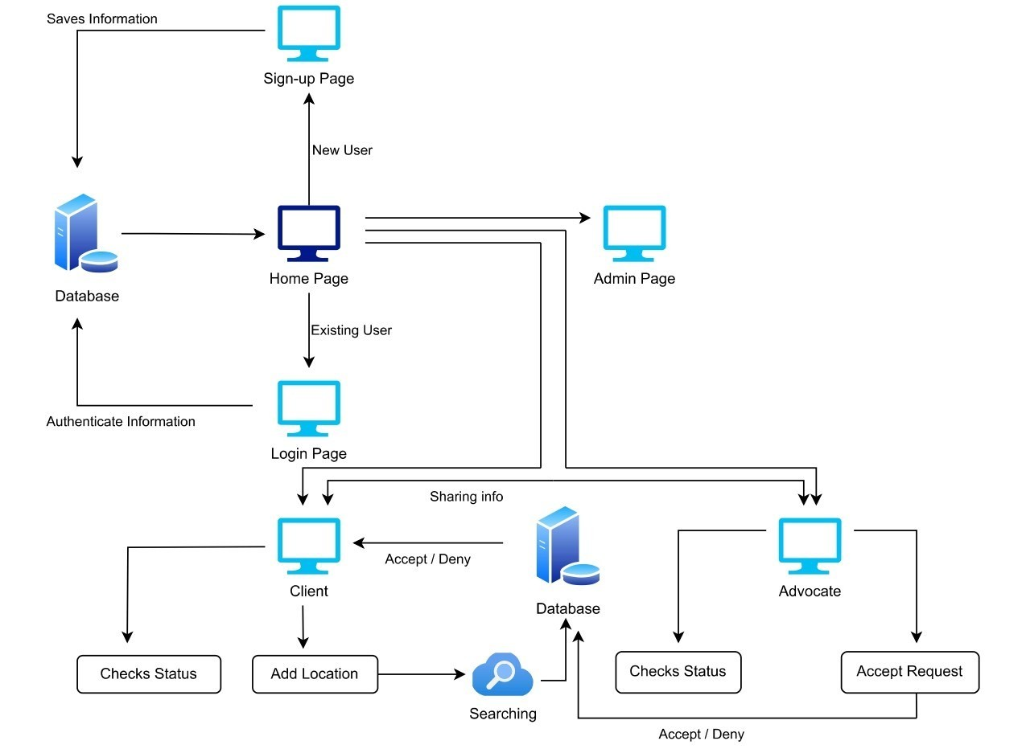
SYSTEM ARCHITECTURE

Slide 12

FUTURE SCOPE
Developing a mobile application can make the platform more accessible and convenient for users. A mobile app would allow clients and lawyers to engage with the platform on-the-go, facilitating a seamless experience.
Evolving into a comprehensive legal marketplace ecosystem where additional legal services, such as legal document creation, mediation services, or dispute resolution mechanisms, can be offered.
Might include integrating features such as virtual consultations, document automation, or AI-driven legal research tools.
The platform can explore opportunities to expand its services to cover a broader geographic area.
Offering educational resources to users, such as legal guides, FAQs, or informative content about various legal processes, could enhance the overall user experience.

Slide 13
CONCLUSION
Our website fills a crucial gap left by eCourtServices, the government app for court-related tasks, by offering a dedicated platform for searching lawyers, a functionality absent in the former. By providing users with the ability to access legal services remotely, our website significantly reduces the need for physical travel, thereby cutting down on associated expenses. Moreover, it eliminates the inefficiencies of traditional lawyer search methods, streamlining the process and saving users valuable time. This initiative not only addresses the limitations of existing state applications but also exemplifies a modern approach to accessing legal assistance, enhancing convenience and accessibility for users seeking legal representation.
Hence , the “Court at Door” website overcomes the traditional searching method
of lawyers

Slide 14






THANK YOU

